Slide 2
Mantle cell lymphoma
Dr. Raeisi

Slide 3
Mantle cell lymphoma (MCL) is one of the mature B cell non-Hodgkin lymphomas.
While it is often discussed together with the clinically indolent forms of NHL, its behavior is more often that of an aggressive disease.

Slide 4
MCL comprises about 7 percent of adult non-Hodgkin lymphomas in the United States and Europe.
Approximately three-quarters of patients are male.
Median age at diagnosis is 68 years.

Slide 5
Most patients present with diffuse lymphadenopathy and splenomegaly.
B symptoms are present in 25% to 50% of patients, and 15% to 30% have or will develop a unique gastrointestinal presentation with multiple lymphomatous polyposis.

Slide 6
Bone marrow involvement is detected in 60% to 90% of patients, and up to 25% will have an overt leukemic phase, although most patients have a small circulating clone detectable by FC.
CNS involvement has been documented in 9% of patients during the course of the illness, usually as a late event.

Slide 7
MCL is thought to have two distinct cellular origins, each giving rise to different forms of the disease :
●Classical MCL typically involves lymph nodes and extranodal sites, such as the gastrointestinal tract. Classical MCL is believed to arise from naïve B cells that express SOX11, which is not normally expressed in B cells; SOX11 has been reported to block B cell differentiation, suggesting that it has a direct role in MCL pathogenesis.

Slide 8
●The "leukemic" variant of MCL mainly involves the peripheral blood, bone marrow, and/or spleen and often spares lymph nodes.
This variant develops from antigen-experienced SOX11-negative B cells and is often clinically indolent, but may acquire secondary abnormalities (eg, TP53 mutations) that lead to a very aggressive course.

Slide 9
Both types of MCL are highly associated with a (11;14) translocation that dysregulates the cyclin D1 gene (CCND1).

Slide 10
Patients suspected of having MCL should undergo tissue biopsy. In addition to routine histology and immunohistochemistry, involvement of cyclin D1 should be evaluated by immunohistochemistry.
Cytogenetic detection of the t(11;14) by either karyotyping or fluorescence in situ hybridization (FISH) is a useful adjunct test.

Slide 11
On histologic review, tumor cells are usually monomorphous small to medium-sized B lymphocytes with irregular nuclei.
Tumor cells are typically CD5+ and CD23–; the vast majority overexpress cyclin D1 .

Slide 12
The t(11;14) translocation, which is not specific for MCL, is seen in a little over half of patients on conventional cytogenetics, but on a much higher percentage of patients screened with FISH.
SOX11 staining can be helpful in rare cases that fail to express cyclin D1.

Slide 13
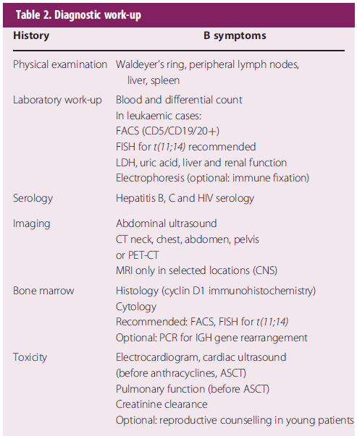

Slide 14
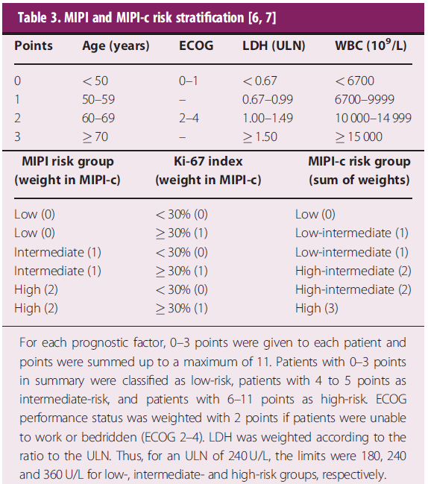

Slide 15
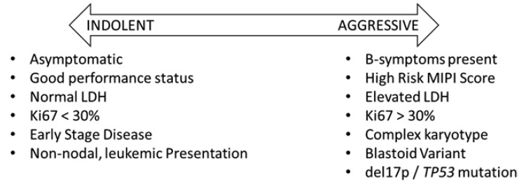

Slide 16
Treatment

Slide 17
Stages I–II: A shortened conventional chemotherapy (ChT) induction followed by consolidation RT (similar to diffuse large cell lymphoma) may be the most appropriate treatment in these cases.

Slide 18
In stage I–II patients with large tumour burden or adverse prognostic features, systemic therapy as indicated for advanced stages should be applied; consolidation RT may be considered depending on tumour location and expected side-effects.

Slide 19
Stages III–IV

Slide 20
Elderly patients
Based on a median age of 65 years at first diagnosis, the majority of patients do not qualify for dose-intensified regimens.
Rituximab in combination with ChT such as CHOP or bendamustine should be used.
Recently, rituximab, bendamustine and cytarabine (R-BAC) has been explored also in first-line therapy.

Slide 21
Elderly patients
In frail patients, a less intense immunochemotherapy, chlorambucil or vincristine, doxorubicin, oral dexamethasone and chlorambucil (VADC) or prednisone, etoposide, procarbazine and cyclophosphamide (PEP-C) may be considered, aiming primarily at palliation . However, targeted therapy exhibiting a low toxicity profile might be used in this population.

Slide 22
Elderly patients
Antibody monotherapy [rituximab, radioimmunotherapy (RIT)] achieves only moderate response rates and is therefore not recommended.

Slide 23
Elderly patients
Consolidation/maintenance
Rituximab maintenance significantly improves PFS and OS after rituximab and CHOP (R-CHOP) and PFS in a systematic meta-analysis.
RIT consolidation also prolongs PFS after ChT, but its benefit seems to be inferior in comparison to rituximab maintenance.

Slide 24
Younger patients
Although no curative treatment is available for MCL so far, an intensive approach, e.g. by autologous stem cell transplantation (ASCT), has been demonstrated to induce higher response and survival rates in fit patients, independently of the addition of rituximab.

Slide 25
Younger patients
Rituximab maintenance following a rituximab with dexamethasone, cytarabine and cisplatin (R-DHAP)-based induction and ASCT improves PFS and OS and represents the current standard of care.
So far, there are no data to support the application of allogeneic stem cell transplantation (alloSCT) as part of front-line treatment.

Slide 26
Stages III–IV

Slide 27
Studies of Aggressive Induction Regimens Including ASCT

Slide 28
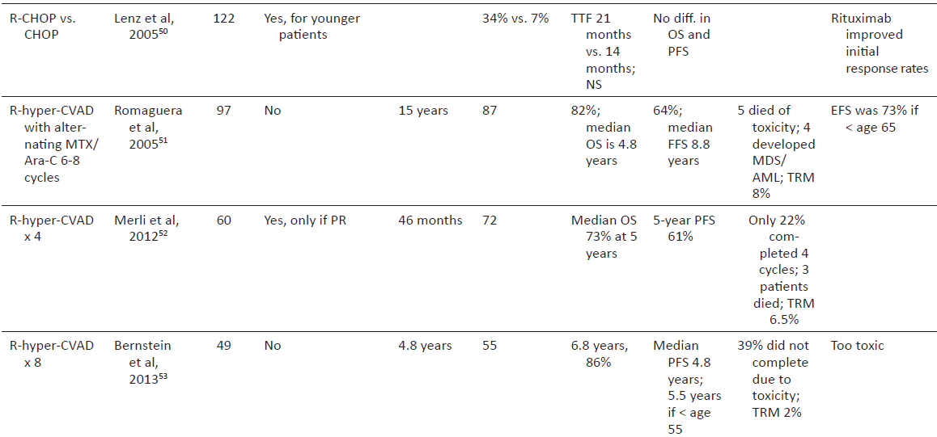

Slide 29
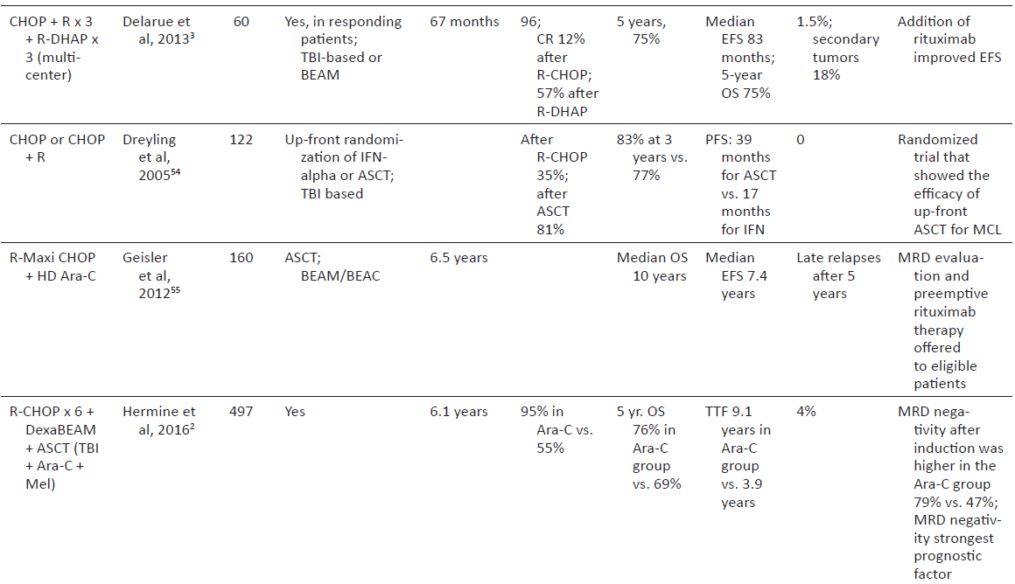

Slide 31
Predictors of response after ASCT
Despite high response rates, the approaches described above are challenging and there is significant risk of toxicity and second malignancies.
In addition,10% to 30% of patients undergoing aggressive induction never make it to ASCT either because of chemotherapy resistance or complications such as infections or cardiac events.
A careful evaluation of some of the larger series has pointed to a few prognostic factors that can be used to predict outcomes particularly after ASCT, including MIPI/MIPI-b, MRD status, and PET scan response prior to transplant.

Slide 32
Relapsed disease

Slide 33
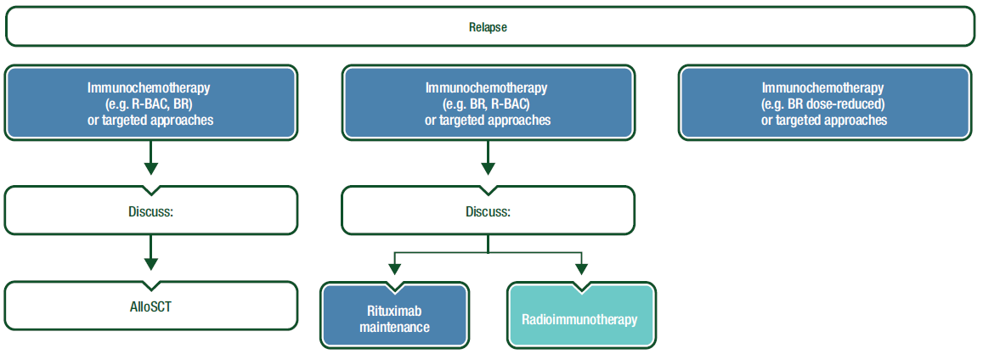

Slide 35
ASCT in MCL is less effective when offered to patients in the relapsed disease with median PFS of 1 to 2 years.
Outcomes of patients undergoing ASCT was better in first complete remission when compared with transplants performed later in the disease, even when chemotherapy sensitivity was demonstrated.

Slide 36
The use of radio-immunotherapy (RIT) in conditioning regimens may be a way to improve outcomes, and this approach has been reported.

Slide 37
Allogeneic Stem Cell Transplant for MCL
In spite of improved outcomes seen in MCL with the above described approaches, nearly all patients with MCL will relapse.
The median OS of patients who relapse after ASCT is reported at 19 months, though this may change with the approval of newer targeted agents.
AlloSCT remains an option for suitable patients and can lead to long-term remissions and potential cures.

Slide 38
Allogeneic Stem Cell Transplant for MCL
The use of an alloSCT in relapsed lymphoma elicits a graft-versus-lymphoma effect allowing for long-term remissions, albeit at a risk of graft-versus-host disease, infections, and organ dysfunction that can lead to a risk of transplant-related mortality.
The use of a reduced intensity-conditioning regimen relies on graft-versus-lymphoma effect and reduced acute toxicity allowing its use in elderly and frail patients or in patients who have failed an earlier myeloablative ASCT.

